Slide 1
Carrots and Genomics
An Introduction to the application of Molecular Markers

Slide 2
Outline of presentation
General introduction
The plant cell
DNA
Cell division, production of gametes
PCR
Molecular Markers
Application in carrot breeding

Slide 3
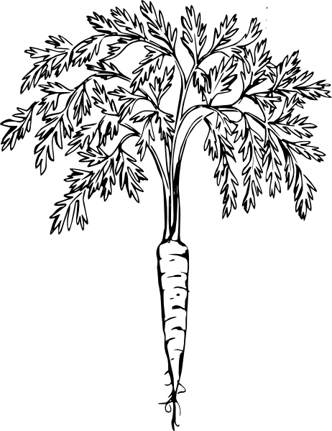
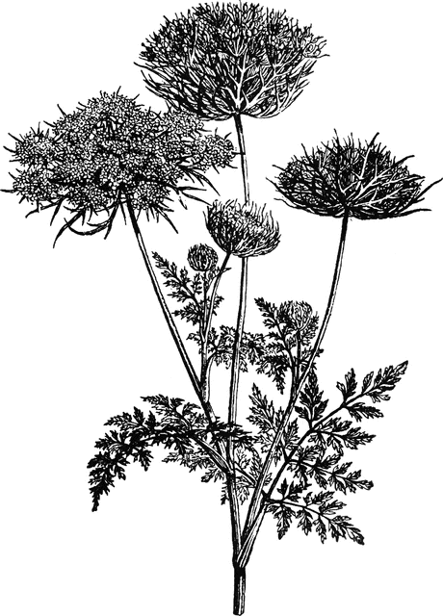
The plant

Slide 4
The plant cell
Cell wall
Cell membrane
Cytoplasm
Mitochondrion
Vacuole
Nucleus
nuclear DNA
(Chloroplast)

Slide 5
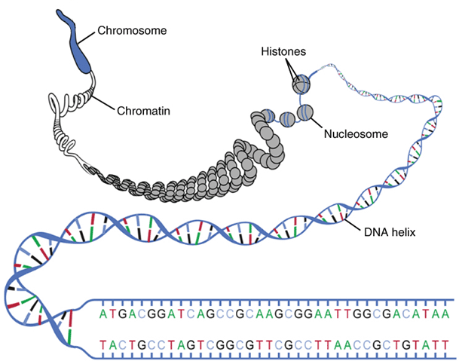
Nucleus with DNA
2n = 18
Total size carrot genome:
473 Mbp
Notes:
Zoom in on nucleus 9 different chromosomes
Diploid species, 2 copies of each chromosome, one from mother and one from father, 18 in total
Zoom in on chromosome, folded complex of proteins and DNA
DNA forms a double helix, consists of two separate strands of nucleotides.
The nucleotides form basepairs connecting the two strands.
4 different nucleotides: A, T, C en G. The two strands are complementary to each other, since A always pairs with T and C always with G.
The order of nucleotides is called a sequence and this encodes genetic information.
The total size of the carrot genome is 473 Mbp

Slide 6
The plant
Within a plant, all plant cells contain the same DNA
For plant growth, cells need to divide
Prior to cell division → DNA duplication

Slide 7
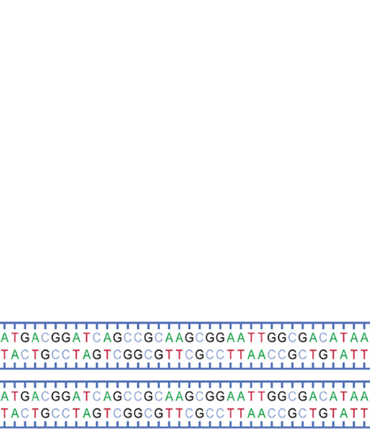
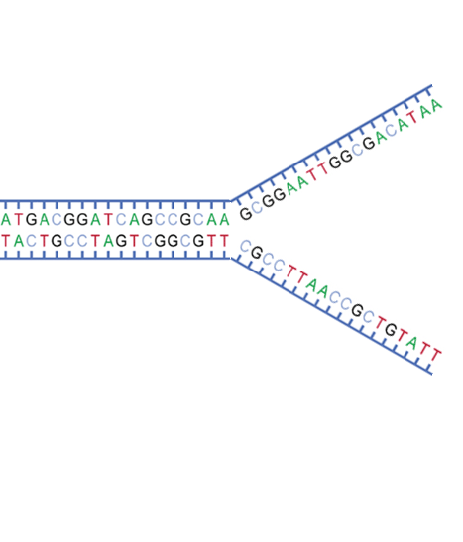
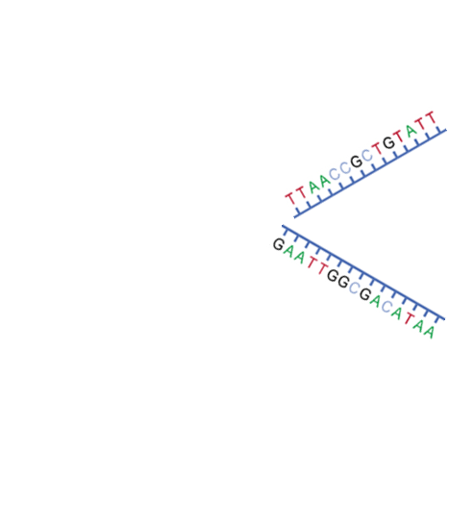
DNA duplication
Double stranded DNA
Separation of two strands
Incorporation of
nucleotides
Two copies of
double stranded DNA
Notes:
The first step is to separate the two strands
Since the strands are complementary, they can both act as template for two new strands.
The correct nucleotides are linked one by one to the new strands
After duplication is finished, there are two exact copies of the original ds DNA

Slide 8
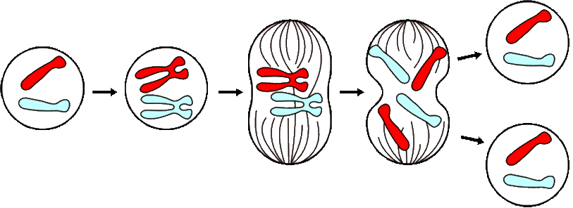
Cell Division
DNA duplication
Mitosis
2 identical diploïd cells
Notes:
After duplication has finished, the cell can divide itself and both cells still have the same DNA content. In this way all plant cells are identical for their DNA content.

Slide 9
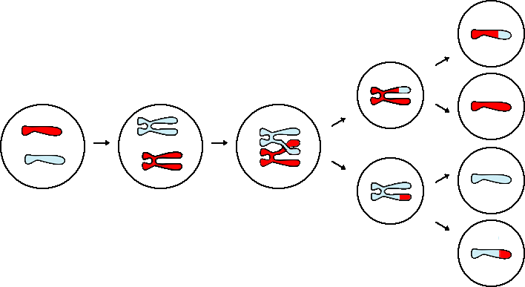
Production of gametes
DNA duplication
Meiosis
4 unique
haploïd gametes
Notes:
Also during the production of the gametes (eggcells and pollen grains) the first step is DNA duplication. After DNA duplication, the 2 copies of each chromosome lign up and a crossover may occur: two strands break at the same position and reconnect to the other copy. The two copies are divided over two different cells, which are again divided over two cells. This results in 4 haploid gametes with or without crossing-overs. On average their will be one crossing-over per chromosome.

Slide 10
Summary
A plant consists of many different cells, each with identical DNA content
DNA consists of two complementary strands
During duplication, each strand acts as a template to produce two identical copies
Duplication of DNA occurs prior to:
Cell division → two identical diploïd cells
Gamete production → four unique haploïd cells

Slide 11
PCR
Polymerase Chain Reaction
Amplification of DNA
Mimics the process of DNA duplication in the plant
The polymerase (enzyme) requires dsDNA to start building in nucleotides
Notes:
The DNA duplication can also be done in the lab

Slide 12
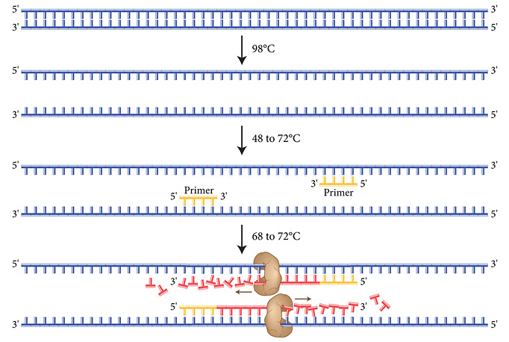
PCR
denaturation
annealing
elongation
Notes:
Usually only a small region of interest needs to be amplified
After denaturation DNA is single stranded
polymerase can only elongate ds DNA, we need a starting point.
by adding small artificial pieces of DNA called primer with identical sequence to the region of interest,
In order to make the primers, we need to know the sequence of the region of interest

Slide 13
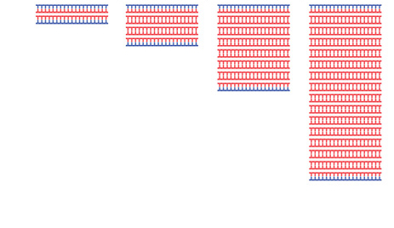
PCR
1st cycle —› 2nd cycle —› 3rd cycle —› 4th cycle ‒ ‒ – —› 30th cycle
2³⁰ ~ 1 billion copies
2¹ = 2 copies
2² = 4 copies
2³ = 8 copies
2⁴ = 16 copies
PCR: amplification of a specific region of the genome defined by the sequence of the primers used in the reaction
Notes:
We can repeat the duplication (chain reaction)
As a result, the amount of amplified DNA is much higher than the total DNA added to the reaction.

Slide 14
Molecular Markers
Amplify a specific region of the genome through PCR
Visualize the amplified fragment
Perform this step for different parent lines
When an amplified fragment is different for two parent lines it becomes a molecular marker
Notes:
If we have the sequence, we can make specific primers to amplify the specific region

Slide 15
Molecular Markers
A B M
600 bp
M is a molecular size marker
500 bp
400 bp
300 bp
200 bp
100 bp
Notes:
Molecular marker is defined by it’s two primers

Slide 16
Molecular Markers
Testing the % of inbreds in a hybrid seedlot
(example from cabbage)
A B M
Individual seedlings from a hybrid seedlot

Slide 17
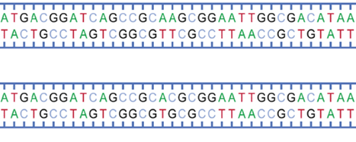
Molecular Markers: SNP
Single Nucleotide Polymorphism
Sequence information from multiple parent lines
SNP discovery:

Slide 18
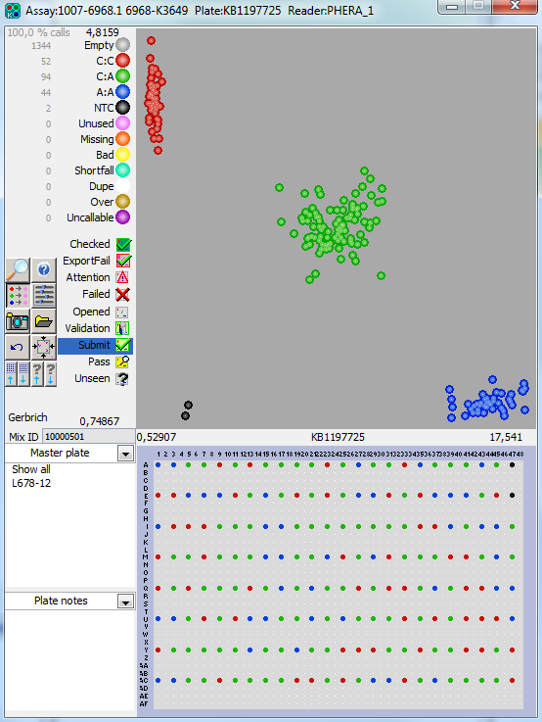
Molecular Markers: SNP
384 SNPs
192 samples
per day

Slide 19
Applications in carrot breeding
Mapping a trait

Slide 20
Mapping a trait
Create a population segregating for your trait (~250 individuals)
Genotype the population
Phenotype the population
Combine these data to find the location of your trait on the genome

Slide 21
Mapping a trait
A
B
F1
Crossing
X
Selfing
(plant forms gametes)

Slide 22
Producing gametes
DNA duplication
Meiosis
4 unique
gametes

Slide 23
Mapping a trait
A
B
F1
Crossing
X
Selfing
F1S1 population

Slide 24
Mapping a trait
Genotyping
b h h h h a a h h b b a b h b h a h
b h b h h a h h h b h a b h b h a h
h h b a h a b b h b h h b h h h a h
a h h a h h b b h h h h b b a h a a
a b h a h h b h h a a b b b a b a a
a b a a h b b h b a a b h h a b a h

Slide 25
Mapping a trait
Phenotyping
r r s r r r s r r s r r s r s r r r

Slide 26
Mapping a trait
Combining data
b h h h h a a h h b b a b h b h a h
b h b h h a h h h b h a b h b h a h
r r s r r r s r r s r r s r s r r r
h h b a h a b b h b h h b h h h a h
a h h a h h b b h h h h b b a h a a
a b h a h h b h h a a b b b a b a a
a b a a h b b h b a a b h h a b a h
Notes:
cosegregation

Slide 27
Mapping a trait
Combining data
b h b h h a h h h b h a b h b h a h
h h b h h a b h h b h h b h b h a h
r r s r r r s r r s r r s r s r r r
h h b h h a b h h b h h b h b h a h
h h b a h a b b h b h h b h h h a h
Notes:
cosegregation

Slide 28
Mapping a trait
Errors in scoring make the analysis more complex
Better phenotyping results in better mapping
Easy for traits determined by a single gene: one locus on the genome

Slide 29
Mapping a trait
For complex traits use QTL mapping
QTLs: Quantative Trait Loci
Genotyping and phenotyping a population
Use computer software to statistically calculate the positions on the genome (loci) that have an influence on the trait.

Slide 30
Advantages for carrot breeding
Dominant resistance: markers can distinguish homozygous and heterozygous resistant plants
Recessive resistance: markers can distinguish heterozygous and homozygous susceptible plants
Combine resistance genes

Slide 31
Advantages for carrot breeding
Molecular markers provide an additional tool for breeders to select for their traits of interest.
Selection with markers can be done at any stage with any part of the plant
New possibilities to combine traits of interest to create even better carrots

